Slide 1





Guide
Using technology to make public transportation accessible
Group 3
Maggie Luong & Allyson Yu

Slide 2


UN Problem: No Poverty
38%
Importance
Economic growth must be inclusive to provide sustainable jobs and promote equality.
of people with visual impairments* have turned down a job because of public transportation concerns
Why?
Septa and the Septa Mobile Application is currently not accessible to all users.
16%
of Philadelphia citizens have a (dis)ability
Am I at the right stop?
Will the conductor announce the station?
Will I be able to safely get to and from work?”
* Encompasses individuals who may have lost their vision or may have difficulty with viewing

Slide 3


Making Public Transportation Accessible
Provides Philadelphians with visual impairments the opportunity to commute to work via subway safely
Promotes equitable access to public transportation
Encourages reliability to employment
Combats barrier to employment
Passage to labor, which can combat poverty

Slide 4

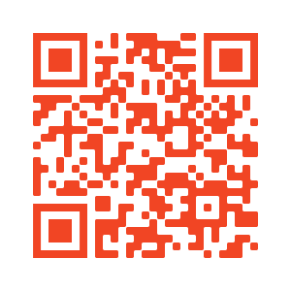
Prototype
https://mis3502-luong.com/septa/
Try it on the Chrome browser with (and without) a screen reader.

Slide 5
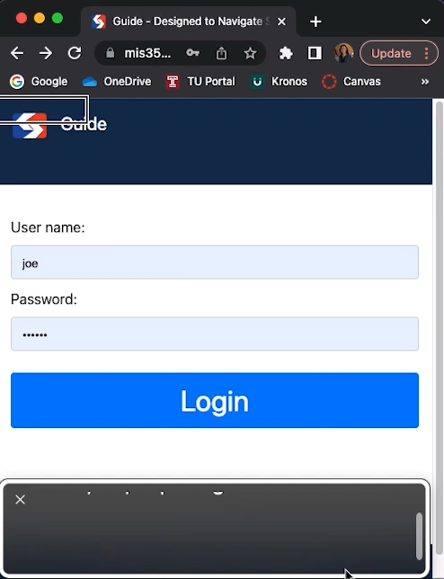

Demo with Screen Reader
Login page
Main page

Slide 6
Demo with Screen Reader
Create a trip and edit trip. Includes direction, geolocation, geofence, ring, and alert.
Navigation bar and history

Slide 7
Next Steps
Improve the look and feel to fit Septa
Improve screen reader compatibility
Perform user testing with groups of visually impaired individuals and non-visually impaired individuals
Store favorite trips
Mobile development
Add pages beyond index.html
Implement more third-party APIs
Improve geolocation
Alerts
Septa
Refine geofence for accuracy
Expand to Market-Frankford Line
Limit number of alerts and rings

Slide 8
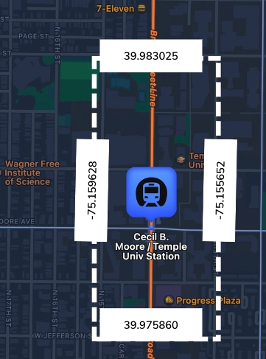
Innovation
Feature does not exist... yet
Geolocation
SEPTA app does not have this feature
Rings and informs the user when within the station's geofence
Not a map
Leverages geofencing
Informs the user on station location
Updates in real time
Figure 1: Geofence of Cecil B. Moore Station.
The application grabs the user’s geolocation (with permission). The user’s current geolocation is compared to the station’s geofence. If it is within range, the user will be informed.
User Experience (UX)
Follows Web Content Accessibility Guidelines (WCAG) 2.1
Pairs with screen readers
Skip to main

Slide 9


Business Considerations
Enhance diversity and inclusion
Minimize legal risk
Drive innovation

Slide 10
Thank You for
Letting Us Guide You
Questions & Comments

